Slide 1
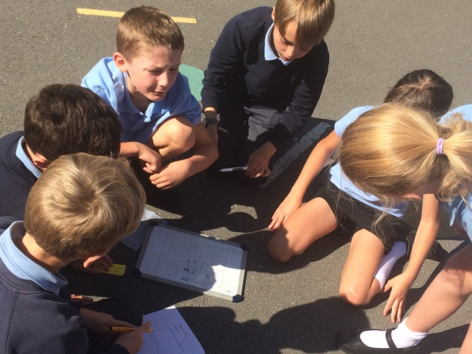
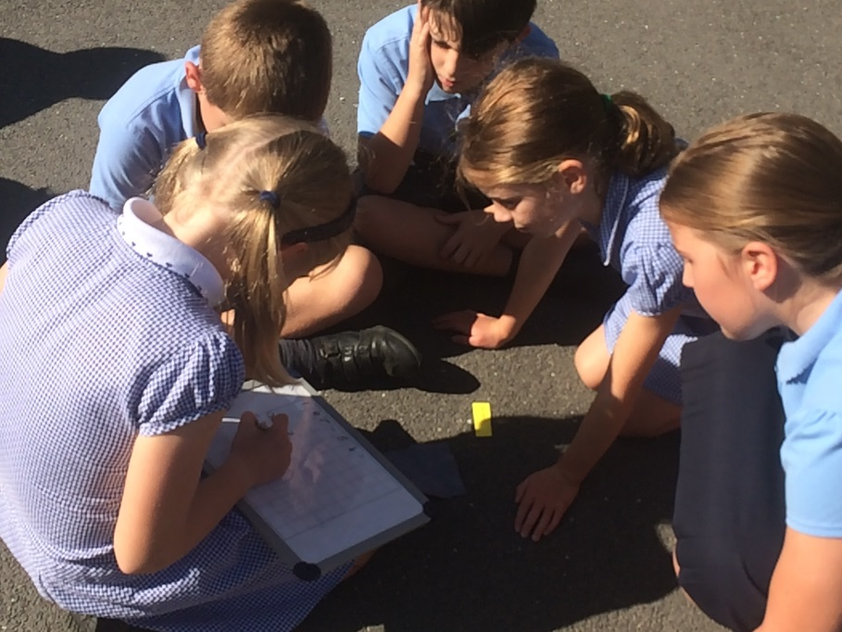
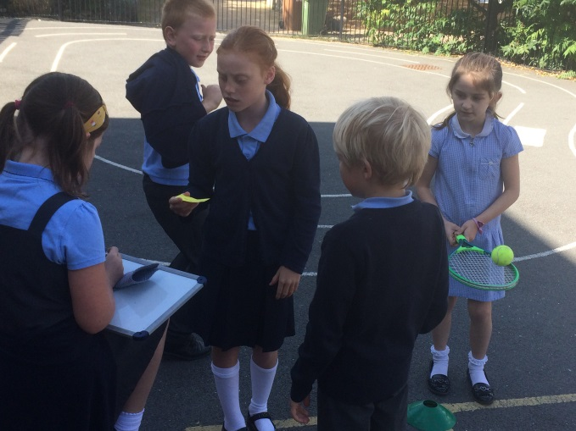
Welcome to our Maths Calculation Evening

Slide 2
What will we cover?
The mastery approach to mathematics
Addition
Subtraction
Multiplication
Division
Useful apps and websites
Questions or comments

Slide 3
What is mastery?
The essential idea behind the mastery teaching approach is that all pupils gain a deep understanding of the mathematics. This ensures that:
future mathematical learning is built on solid foundations which do not need to be re-taught (less breadth but greater depth)
Increasingly, there will be less need for separate catch-up programmes due to some children falling behind;
pupils who, under other teaching approaches, can often fall a long way behind, are better able to keep up with their peers, so that gaps in attainment are narrowed whilst the attainment of all is raised.
Notes:
The essential idea behind the mastery teaching approach is that all pupils gain a deep understanding of the mathematics. This ensures that:
future mathematical learning is built on solid foundations which do not need to be re-taught (less breadth but greater depth)
Increasingly, there will be less need for separate catch-up programmes due to some children falling behind;
pupils who, under other teaching approaches, can often fall a long way behind, are better able to keep up with their peers, so that gaps in attainment are narrowed whilst the attainment of all is raised.

Slide 4
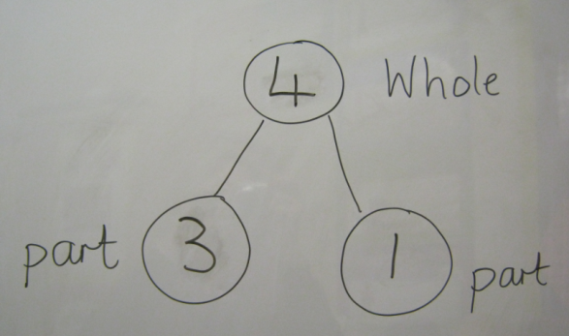
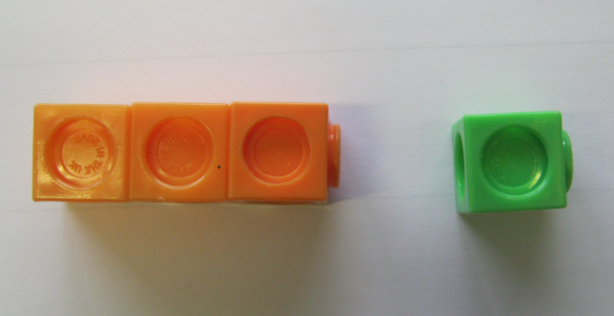
Concrete
Pictorial
Abstract
3 + 1 = 4
Concrete or pictorial representations support students to understand abstract concepts
Notes:
The concrete, pictorial, abstract approach is a progressive teaching strategy to ensure that children’s learning and understanding is deep. Therefore, they can apply this to different contexts and situations.
Concrete refers to the physical resources and objects which children may use to investigate with, identify patters with and reason with others, to reach possible answers / solutions.
Once children are secure with using concrete material to understand an idea they progress to representing the model through pictures and diagrams.
The final stage of children’s understanding is for them to represent the model using numbers and symbols. This is the abstract part of this approach.
In the example above, children are investigating addition of two digits.
They begin using multilink cubes, where the two digits are represented by different colours. They explore what the digit looks like using the resources and the meaning of addition.
They then progress to the pictorial representations. Here you can see two models. The first is a part part whole model and the second is the bar model.
Finally, the children are able to use numbers to represent their investigation.
Through this deep understanding, children will be able to investigate the inverse and explore the subtraction.

Slide 5
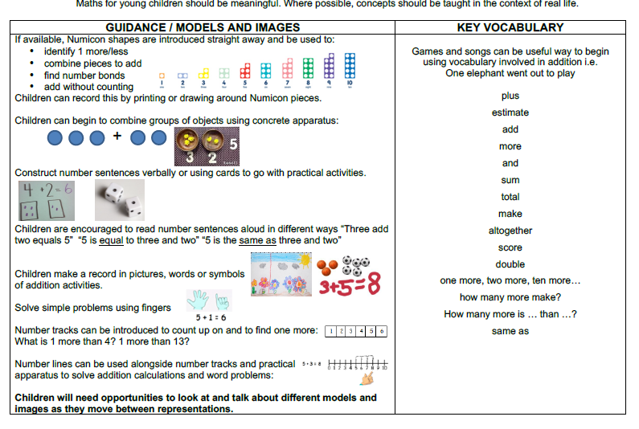
EYFS- Addition

Slide 6
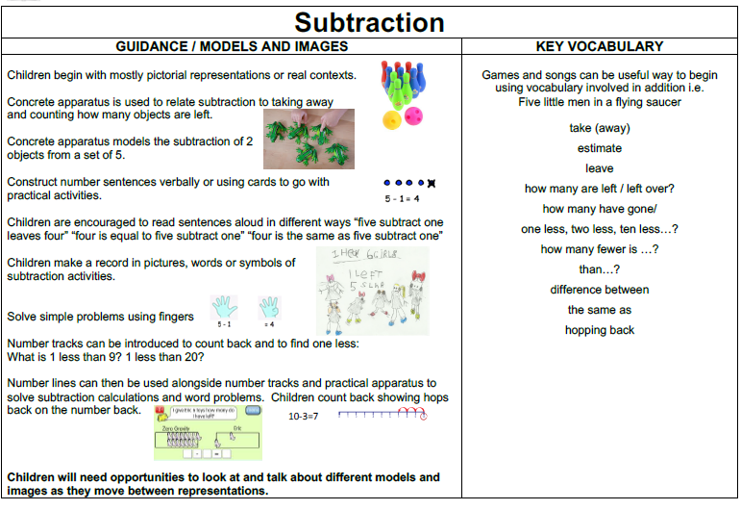
EYFS

Slide 7
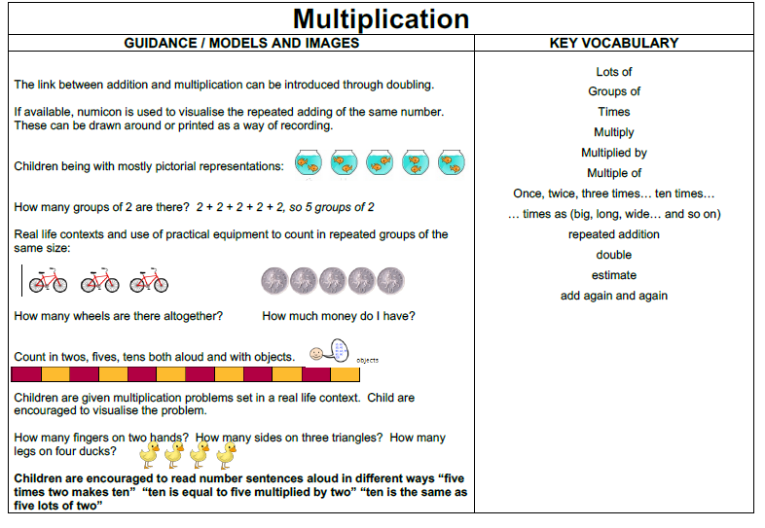
EYFS

Slide 8
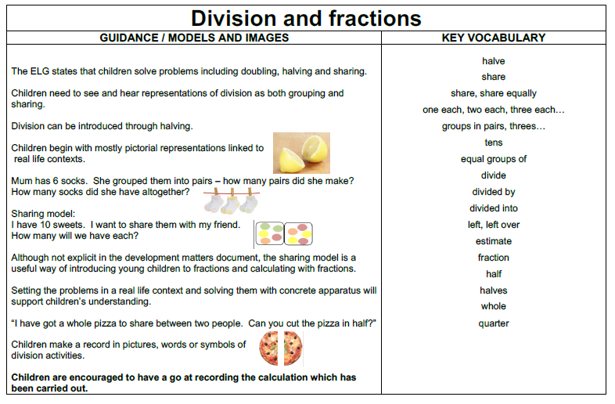
EYFS

Slide 9
Addition- years 1-6

Slide 10

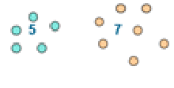
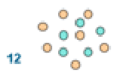
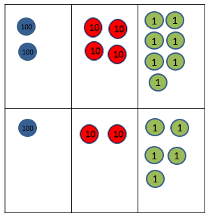



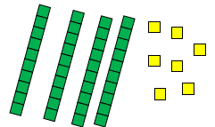
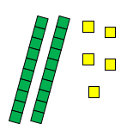
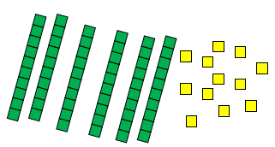
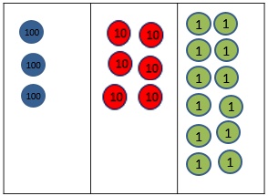
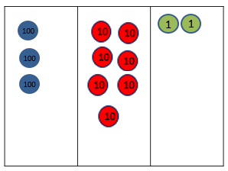
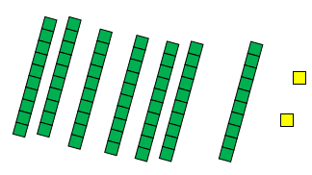


Addition
Year 1 | Year 2 | Year 3
+ = signs and missing numbers Children need to understand the concept of equality before using the ‘=’ sign. Calculations should be written either side of the equality sign so that the sign is not just interpreted as ‘the answer’. 2 = 1+ 1 2 + 3 = 4 + 1 Missing numbers need to be placed in all possible places. 3 + 4 = = 3 + 4 3 + = 7 7 = + 4 Counting and Combining sets of Objects Combining two sets of objects (aggregation) which will progress onto adding on to a set (augmentation) Understanding of counting on with a numbertrack. Understanding of counting on with a numberline (supported by models and images). 7+ 4 | Missing number problems e.g 14 + 5 = 10 + 32 + + = 100 35 = 1 + + 5 Written Method It is valuable to use a range of representations (also see Y1). Continue to use numberlines to develop understanding of: Counting on in tens and ones 23 + 12 = 23 + 10 + 2 = 33 + 2 = 35 Partitioning and bridging through 10. The steps in addition often bridge through a multiple of 10 e.g. Children should be able to partition the 7 to relate adding the 2 and then the 5. 8 + 7 = 15 Adding 9 or 11 by adding 10 and adjusting by 1 e.g. Add 9 by adding 10 and adjusting by 1 35 + 9 = 44 Partitioning in different ways and recombine 47+25 47 25 60 + 12 Leading to exchanging: 72 Expanded written method 40 + 7 + 20 + 5 = 40+20 + 7 + 5 = 60 + 12 = 72 | Missing number problems using a range of equations as in Year 1 and 2 but with appropriate, larger numbers. Partition into tens and ones Partition both numbers and recombine. Count on by partitioning the second number only e.g. 247 + 125 = 247 + 100 + 20+ 5 = 347 + 20 + 5 = 367 + 5 = 372 Children need to be secure adding multiples of 100 and 10 to any three-digit number including those that are not multiples of 10. Towards a Written Method Introduce expanded column addition modelled with place value counters (Dienes could be used for those who need a less abstract representation) Leading to children understanding the exchange between tens and ones. Some children may begin to use a formal columnar algorithm, initially introduced alongside the expanded method. The formal method should be seen as a more streamlined version of the expanded method, not a new method.

Slide 11
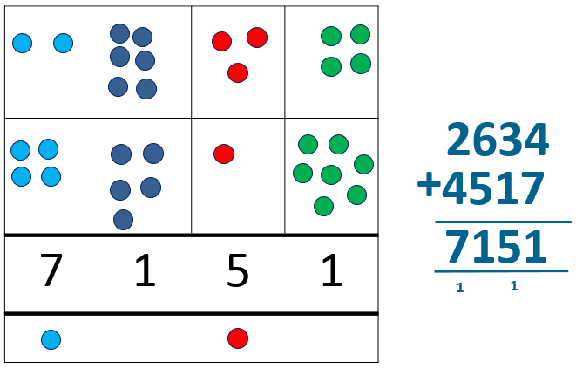
Addition
Year 4 | Year 5 | Year 6
Missing number/digit problems. Written methods (progressing to 4-digits) Expanded column addition modelled with place value counters, progressing to calculations with 4-digit numbers. Compact written method Extend to numbers with at least four digits. Children should be able to make the choice of reverting to expanded methods if experiencing any difficulty. Extend to decimals and adding several numbers (with different numbers of digits). 72.8 + 54.6 127.4 1 1 | Missing number/digit problems. Written methods (progressing to more than 4-digits) As year 4, progressing when understanding of the expanded method is secure, children will move on to the formal columnar method for whole numbers and decimal numbers as an efficient written algorithm. 172.83 + 54.68 227.51 1 1 1 Place value counters can be used alongside the columnar method to develop understanding of addition with decimal numbers. | Missing number/digit problems:. Written methods As year 5, progressing to larger numbers, aiming for both conceptual understanding and procedural fluency with columnar method to be secured. Continue calculating with decimals, including those with different numbers of decimal places Problem Solving Teachers should ensure that pupils have the opportunity to apply their knowledge in a variety of contexts and problems (exploring cross curricular links) to deepen their understanding. .

Slide 12
Subtraction

Slide 13
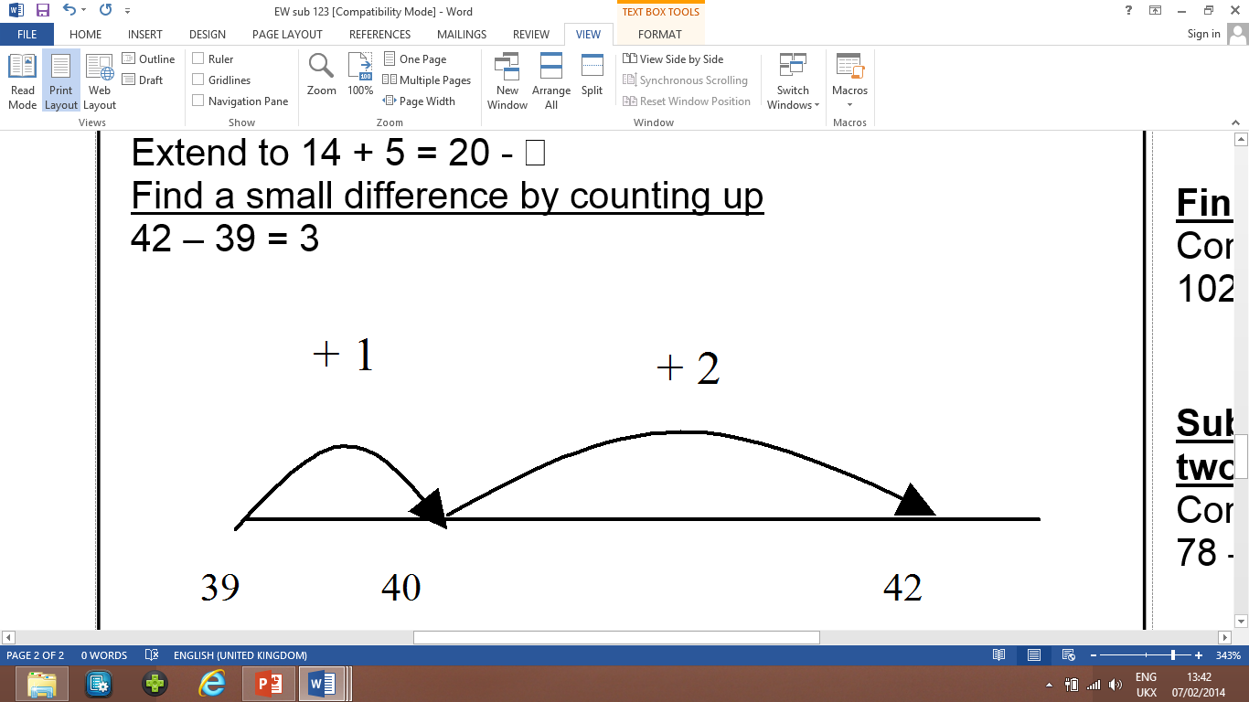
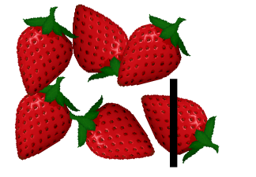
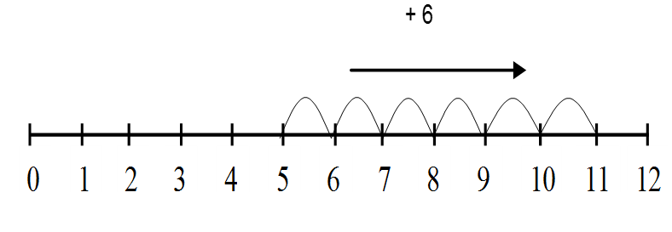
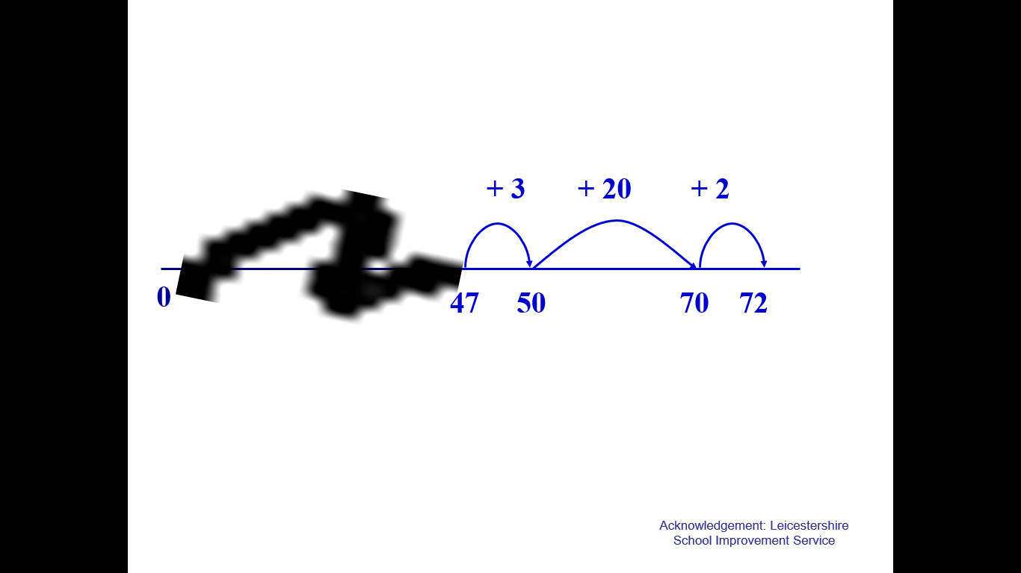
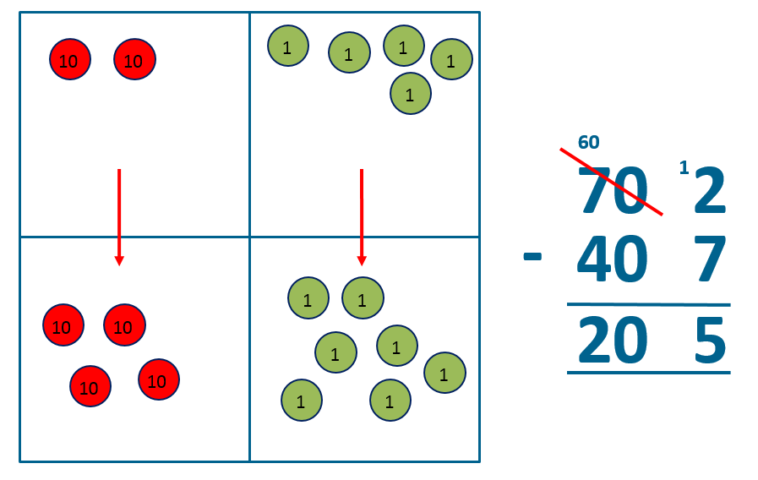
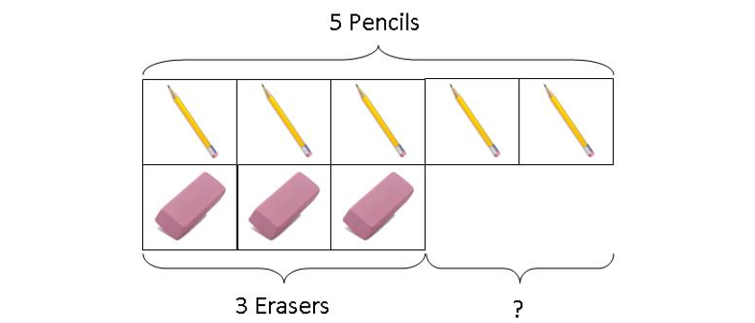
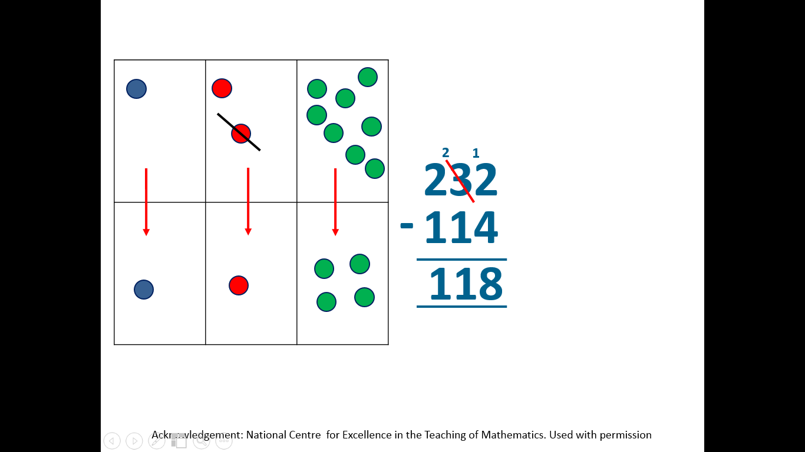
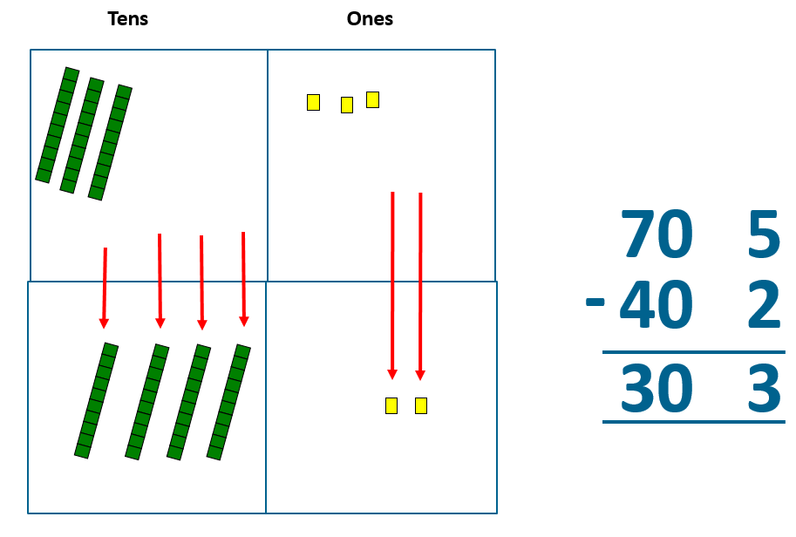
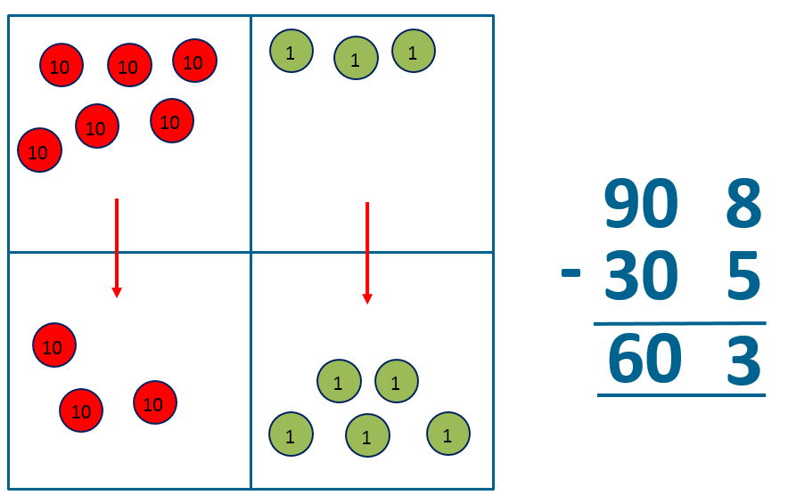
Subtraction
Year 1 | Year 2 | Year 3
Missing number problems e.g. 7 = □ - 9; 20 - □ = 9; 15 – 9 = □; □ - □ = 11; 16 – 0 = □ Use concrete objects and pictorial representations. If appropriate, progress from using number lines with every number shown to number lines with significant numbers shown. Understand subtraction as take-away: Understand subtraction as finding the difference: The above model would be introduced with concrete objects which children can move (including cards with pictures) before progressing to pictorial representation. The use of other images is also valuable for modelling subtraction e.g. Bundles of straws, Dienes apparatus, multi-link cubes, bead strings | Missing number problems e.g. 52 – 8 = □; □ – 20 = 25; 22 = □ – 21; 6 + □ + 3 = 11 Written methods It is valuable to use a range of representations (also see Y1). Continue to use number lines to model take-away and difference. E.g. The link between the two may be supported by an image like this, with 47 being taken away from 72, leaving the difference, which is 25. The bar model should continue to be used, as well as images in the context of measures. Column methods Introduce expanded column subtraction with no decomposition for more able children, however modelled with place value counters (Dienes could be used for those who need a less abstract representation) | Missing number problems e.g. □ = 43 – 27; 145 – □ = 138; 274 – 30 = □; 245 – □ = 195; 532 – 200 = □; 364 – 153 = □ Pencil and paper procedures Complementary addition using a numberline. Column methods (progressing to 3-digits) Expanded column subtraction will lead to exchanging and if secure will move to the more formal method of decomposition as taught in year 4.

Slide 14
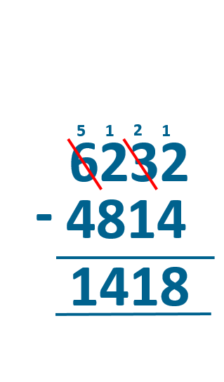
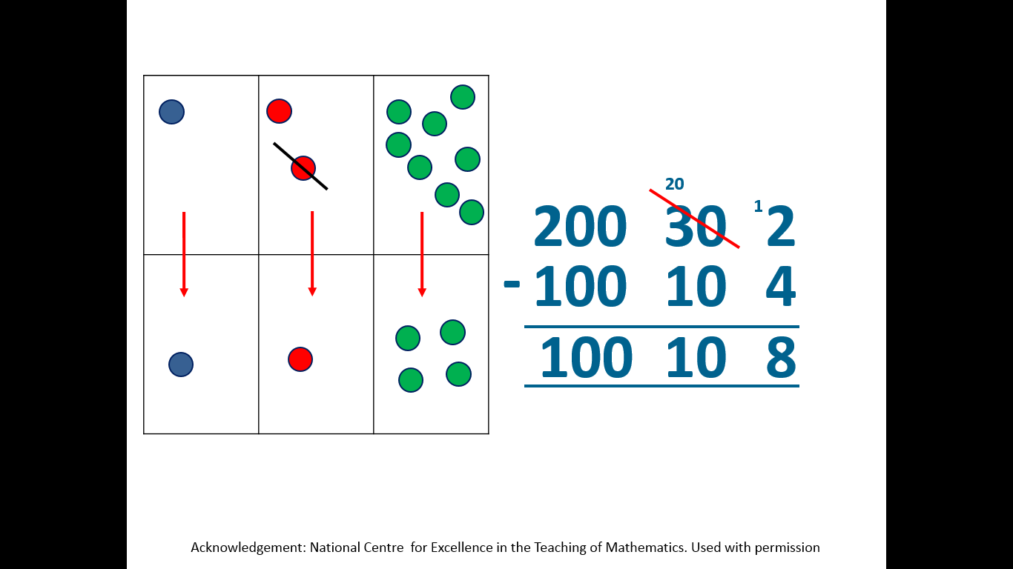
Subtraction
Year 4 | Year 5 | Year 6
Missing number/digit problems: 456 + □ = 710; 1□7 + 6□ = 200; 60 + 99 + □ = 340; 200 – 90 – 80 = □; 225 - □ = 150; □ – 25 = 67; 3450 – 1000 = □; □ - 2000 = 900 Pencil and paper procedures Complementary addition 754 – 86 = 668 Column methods (progressing to 4-digits) Expanded column subtraction with decomposition, modelled with place value counters, progressing to calculations with 4-digit numbers. If understanding of the expanded method is secure, children will move on to the formal method of decomposition, which again can be initially modelled with place value counters. | Missing number/digit problems: 6.45 = 6 + 0.4 + □; 119 - □ = 86; 1 000 000 - □ = 999 000; 600 000 + □ + 1000 = 671 000; 12 462 – 2 300 = □ Column methods (progressing to more than 4-digits) When understanding of the expanded method is secure, children will move on to the formal method of decomposition. Progress to calculating with decimals, including those with different numbers of decimal places. | Missing number/digit problems: □ and # each stand for a different number. # = 34. # + # = □ + □ + #. What is the value of □? What if # = 28? What if # = 21 10 000 000 = 9 000 100 + □ 7 – 2 x 3 = □; (7 – 2) x 3 = □; (□ - 2) x 3 = 15 Written methods As year 5, progressing to larger numbers, aiming for both conceptual understanding and procedural fluency with decomposition to be secured. Teachers may also choose to introduce children to other efficient written layouts which help develop conceptual understanding. Continue calculating with decimals, including those with different numbers of decimal places.

Slide 15
Multiplication

Slide 16

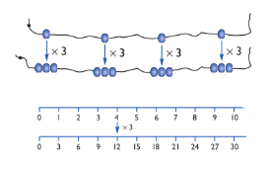
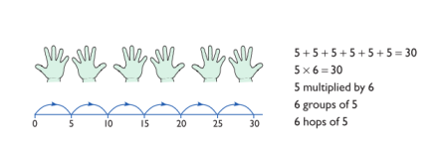
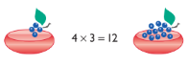
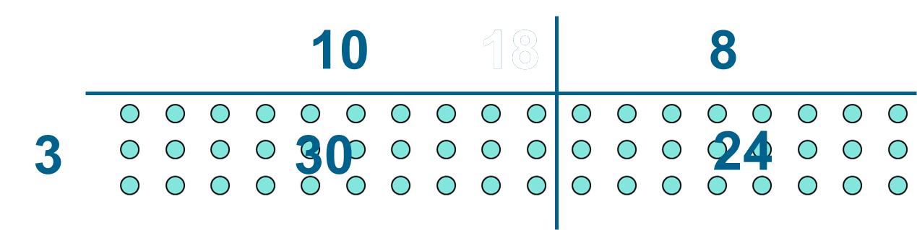
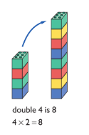
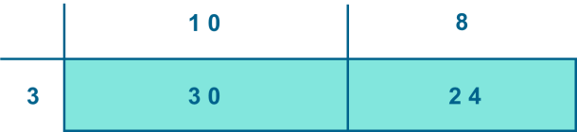
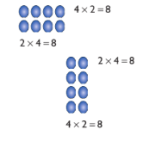
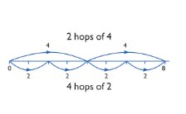
Multiplication
Year 1 | Year 2 | Year 3
Understand multiplication is related to doubling and combing groups of the same size (repeated addition) Washing line, and other practical resources for counting. Concrete objects. Bundles of straws, bead strings Problem solving with concrete objects (including money and measures) Use arrays to understand multiplication can be done in any order (commutative) | Expressing multiplication as a number sentence using x Using understanding of the inverse and practical resources to solve missing number problems. 7 x 2 = = 2 x 7 7 x = 14 14 = x 7 x 2 = 14 14 = 2 x x ⃝ = 14 14 = x ⃝ Develop understanding of multiplication using array and number lines (see Year 1). Include multiplications not in the 2, 5 or 10 times tables. Doubling numbers up to 10 + 10 Link with understanding scaling Using known doubles to work out double 2digit numbers (double 15 = double 10 + double 5) Towards written methods Use jottings to develop an understanding of doubling two digit numbers. Some children develop onto the grid method. 16 10 6 x2 x2 20 12 | Missing number problems Continue with a range of equations as in Year 2 but with appropriate numbers. Written methods Demonstrating multiplication on a number line – jumping in larger groups of amounts 13 x 4 = 10 groups 4 = 3 groups of 4 Grid method Developing written methods using understanding of visual images Develop onto the grid method Give children opportunities for children to explore this and deepen understanding using Dienes apparatus and place value counters Some children may progress to the formal written method of short multiplication.

Slide 17
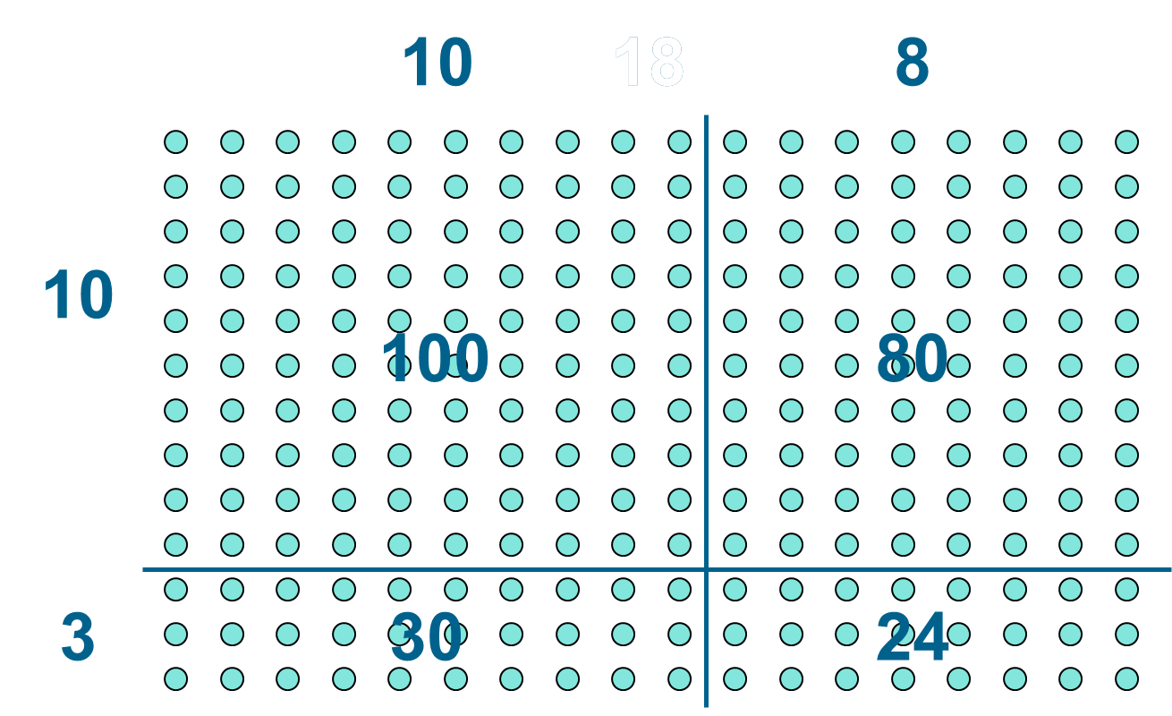
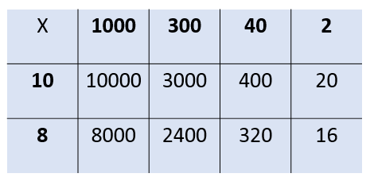
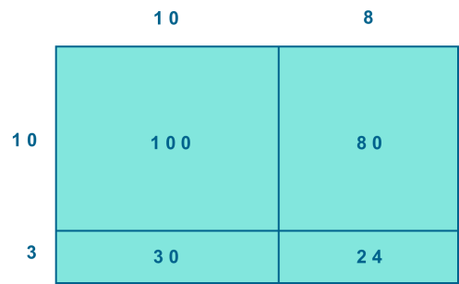
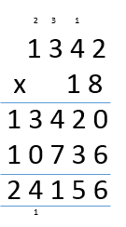
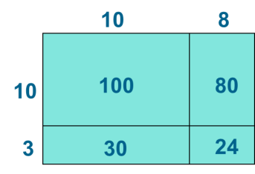
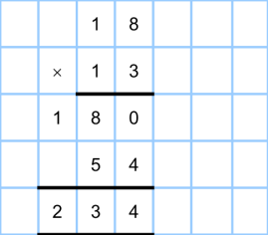
Multiplication
Year 4 | Year 5 | Year 6
Continue with a range of equations as in Year 2 but with appropriate numbers. Also include equations with missing digits 2 x 5 = 160 Written methods Children to embed and deepen their understanding of the grid method to multiply up 2 digit and 3 digit x 1 digit. Ensure this is still linked back to their understanding of arrays and place value counters. Some children may progress to or become more fluent with the formal written method of short multiplication. | Continue with a range of equations as in Year 2 but with appropriate numbers. Also include equations with missing digits Written methods Children to embed and deepen their understanding of the grid method to multiply up 4digits x 1 or 2 digits. Ensure this is still linked back to their understanding of arrays and place value counters. Some children may progress to or become more fluent with the formal written method of short multiplication Long multiplication using place value counters If understanding of short multiplication is secure then children begin to explore how the grid method supports an understanding of long multiplication (for 2digits x 2digits) | Continue with a range of equations as in Year 2 but with appropriate numbers. Also include equations with missing digits Written methods Continue to refine and deepen understanding of Year 5 written methods including long multiplication

Slide 18
Division

Slide 19

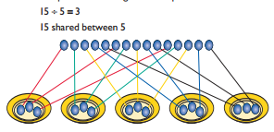
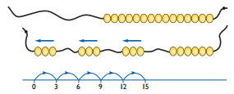

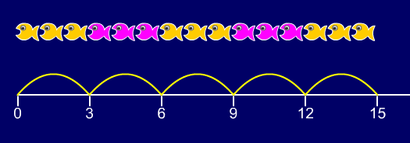


Division
Year 1 | Year 2 | Year 3
Children must have secure counting skills- being able to confidently count in 2s, 5s and 10s. Children should be given opportunities to reason about what they notice in number patterns. Group AND share small quantities- understanding the difference between the two concepts. Sharing Develops importance of one-to-one correspondence. Children should be taught to share using concrete apparatus. Grouping Children should apply their counting skills to develop some understanding of grouping. Use of arrays as a pictorial representation for division. 15 ÷ 3 = 5 There are 5 groups of 3. 15 ÷ 5 = 3 There are 3 groups of 5. Children should be able to find ½ and ¼ and simple fractions of objects, numbers and quantities. | ÷ = signs and missing numbers 6 ÷ 2 = = 6 ÷ 2 6 ÷ = 3 3 = 6 ÷ ÷ 2 = 3 3 = ÷ 2 ÷ ∇ = 3 3 = ÷ ∇ Know and understand sharing and grouping- introducing children to the ÷ sign. Children should continue to use grouping and sharing for division using practical apparatus, arrays and pictorial representations. E.g.numberline Grouping using a numberline Group from zero in jumps of the divisor to find our ‘how many groups of 3 are there in 15?’. 15 ÷ 3 = 5 Continue work on arrays. Support children to understand how multiplication and division are inverse. Look at an array – what do you see? Relate division to fractions. | ÷ = signs and missing numbers Continue using a range of equations as in year 2 but with appropriate numbers. Grouping How many 6’s are in 30? 30 ÷ 6 can be modelled as: Becoming more efficient using a numberline Children need to be able to partition the dividend in different ways (Multiples of the divisor). 48 ÷ 4 = 12 +40 + 8 10 groups 2 groups Remainders 49 ÷ 4 = 12 r1 +40 + 8 + 1 10 groups 2 groups Sharing – 49 shared between 4. How many left over? Grouping – How many 4s make 49. How many are left over? Place value counters can be used to support children apply their knowledge of grouping. For example: 60 ÷ 10 = How many groups of 10 in 60? 600 ÷ 100 = How many groups of 100 in 600? . Relate division to fractions.

Slide 20
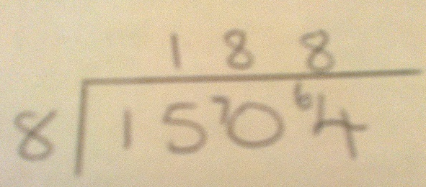
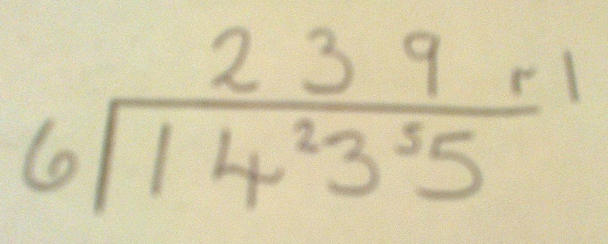
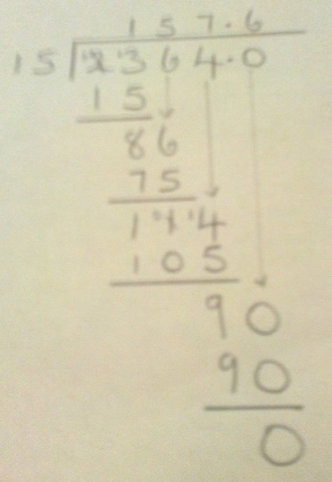

Division
Year 4 | Year 5 | Year 6
÷ = signs and missing numbers Continue using a range of equations as in year 3 but with appropriate numbers. Sharing, Grouping and using a number line Children will continue to explore division as sharing and grouping, and to represent calculations on a number line until they have a secure understanding. Children should progress in their use of written division calculations: Using tables facts with which they are fluent Experiencing a logical progression in the numbers they use including calculations with remainders. Remainders should be interpreted according to the context. (i.e. rounded up or down to relate to the answer to the problem) |  | ÷ = signs and missing numbers Continue using a range of equations but with appropriate numbers Formal Written Methods Children will continue to explore division as in Year 4 and 5 progressing to long division. Quotients should be expressed as decimals and fractions
Formal Written Methods Arrow Method – multiples of the divisor Partition the dividend into multiples of the divisor: e.g 72÷6= 12 10+2=12 6 12 18 24 30 36 42 48 54 60 Formal short division should only be introduced once children have a good understanding of division and its links with multiplication. | Formal Written Methods Continued as shown in Year 4, leading to the efficient use of a formal method progressing to short division. E.g. 1435 ÷ 6 Children begin to practically develop their understanding of how express the remainder as a decimal or a fraction. Ensure practical understanding allows children to work through this (e.g. what could I do with this remaining 1? How could I share this between 6 as well?)
Jottings
7 x 100 = 700
7 x 10 = 70
7 x 20 = 140
e.g. 840 ÷ 7 = 120
100 groups
20 groups
0
700
840

Slide 21
Useful apps and websites
In school we use Mathletics across all year groups and it also is set for homework in Classes 3 and 4.
It allows children to practice their general mental maths skills but also complete more focused tasks or assessments set by their teacher.
Please also see the handout with a range of apps and websites that may help support your child in mathematics.

